Slide 1
Expenzing- Personalized Finance Tracker
~p Malvika Reddy
1nh20cs147

Slide 2
PROBLEM STATEMENT:
Effective finance management and keeping track of your expenses is an important part
of managing one’s overall finances.
Many people struggle to keep track of their personal or business finances, which can
lead to overspending, missed payments, and financial stress.
Traditional methods of tracking expenses, such as using spreadsheets or paper receipts,
can be time-consuming and prone to errors.
An expense tracker web application can address this problem by providing a user-friendly
platform for tracking income and expenses in real-time.
By using an expense tracker web application, individuals can easily monitor their
financial transactions, analyze their spending habits, make informed financial decisions,
avoiding unnecessary expenses and ultimately achieve their financial goals.

Slide 3
OBJECTIVES AND OUTCOMES:
The project would be a expense tracker web application that would help the user track and categorize their income and expenses by providing a rich ui friendly platform.
The web application would also offer informative tools like blogs to help the user learn more about budgeting and money.
These financial blogs can be a valuable resource for individuals who want to learn how to track their expenses effectively and make informed decisions to achieve their financial goals.
It would provide users with expert advice, budgeting tips, real-world examples, etc.

Slide 4
DESIGN METHODOLOGY:
The mini project is being implemented using ReactJs which is a open-source JavaScript library used for building user interfaces.
React uses a component-based architecture. It allows developers to create reusable UI components that can be easily combined to build complex user interfaces. This makes it easier to manage and maintain large codebases, as well as to update and modify the user interface without having to change the underlying code.
The project uses Mui (short for Material-UI) open-source library of pre-built React components. It offers a wide range of UI components, including buttons, cards, forms, icons, menus, modals, tabs, typography.
The project uses React hooks that provide a way to reuse stateful logic across components, and they can make functional components more powerful and easier to understand. These include useState(), useEffect(), useContext() etc.

Slide 5
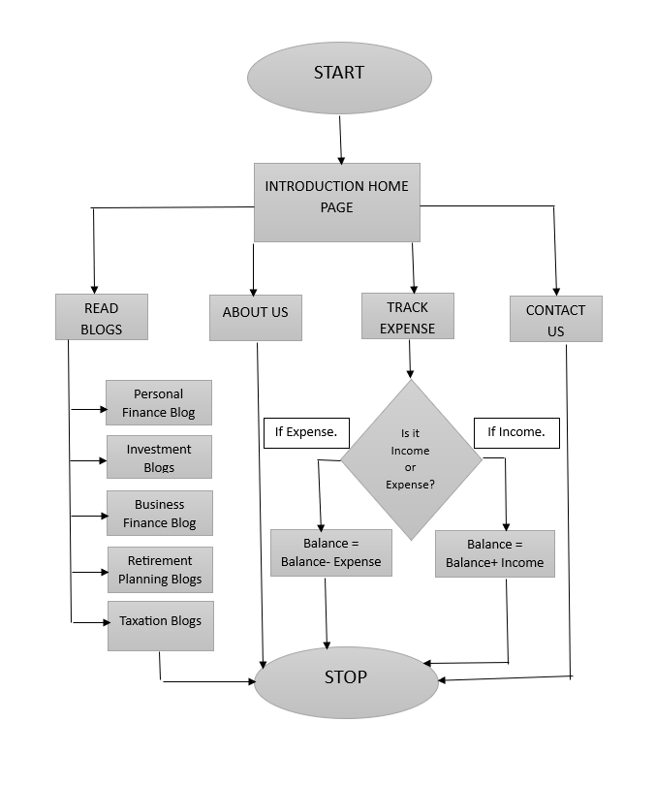
FLOWCHART:

Slide 6
THANK YOU
~ P MALVIKA REDDY
1NH20CS147

